Slide 1
Single Pipe Design for Integrated Community Energy Systems
Presented by: Ryan Rogers, Vick Lakhian, James Cotton
McMaster University – MASc Canddiate
21
Notes:
Masters student from McMaster university department of Mechanical Engineering. Specifically I’m working with the McMaster Institute for Energy Studies to develop the next generations of energy systems.

Slide 2
A Unique Research
Co-operative for a Unique Energy Landscape
17 Industry Partners joined with McMaster and Carleton Universities to form an Energy Research Consortium to tackle the problems facing the Canadian energy landscape with a communities first approach.
Funded by NSERC and OCE to address with a goal to redesign how we interact with energy while increasing resiliency and efficacy of our existing cities from a holistic energy viewpoint.
$2.7 million in funding was awarded to McMaster University to support leading energy system research for its ICE-Harvest Systems Project
ICE-Harvest Systems promotes a VISION of a more sustainable community that produces, utilizes and manages its own energy systems
21

Slide 3




Potential Solution
Integrated Community Energy Systems – A Whole Systems Approach
Thermal Energy Generation
Electrical
Generation
Thermal Energy Storage
Electrical
Storage
21
Notes:
Integrated community energy systems are a whole systems approach that combines both thermal and electrical generation and storage to create a shared energy economy. They’re ideal for high density communities that have mixed use facilities, and to better understand how they fit into the energy landscape, some background is required. Starting with how energy is currently produced and transmitted to the developed world.

Slide 4
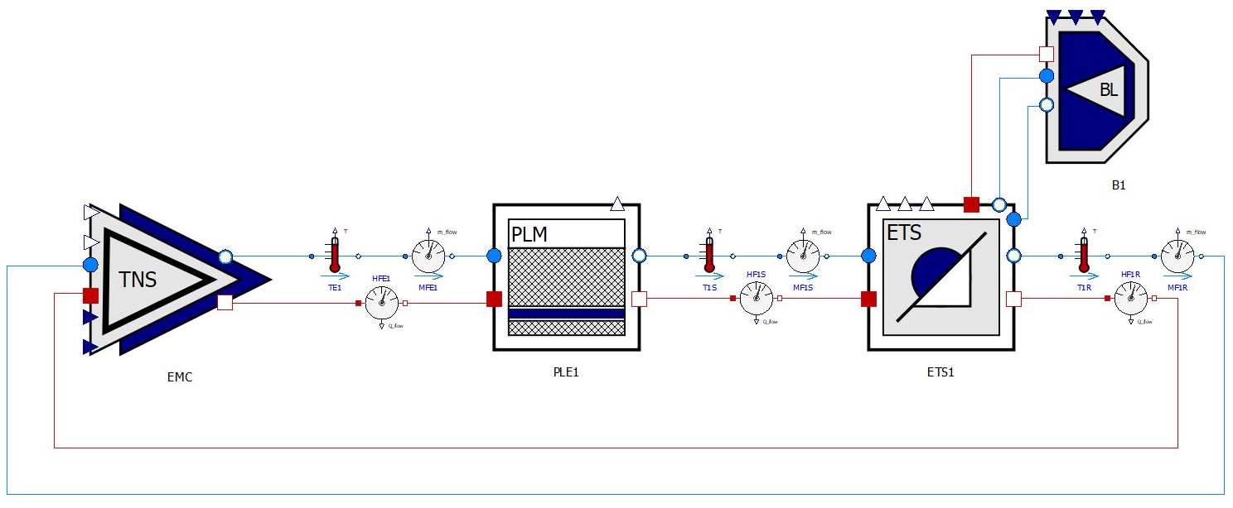
Modelica
6

Slide 5
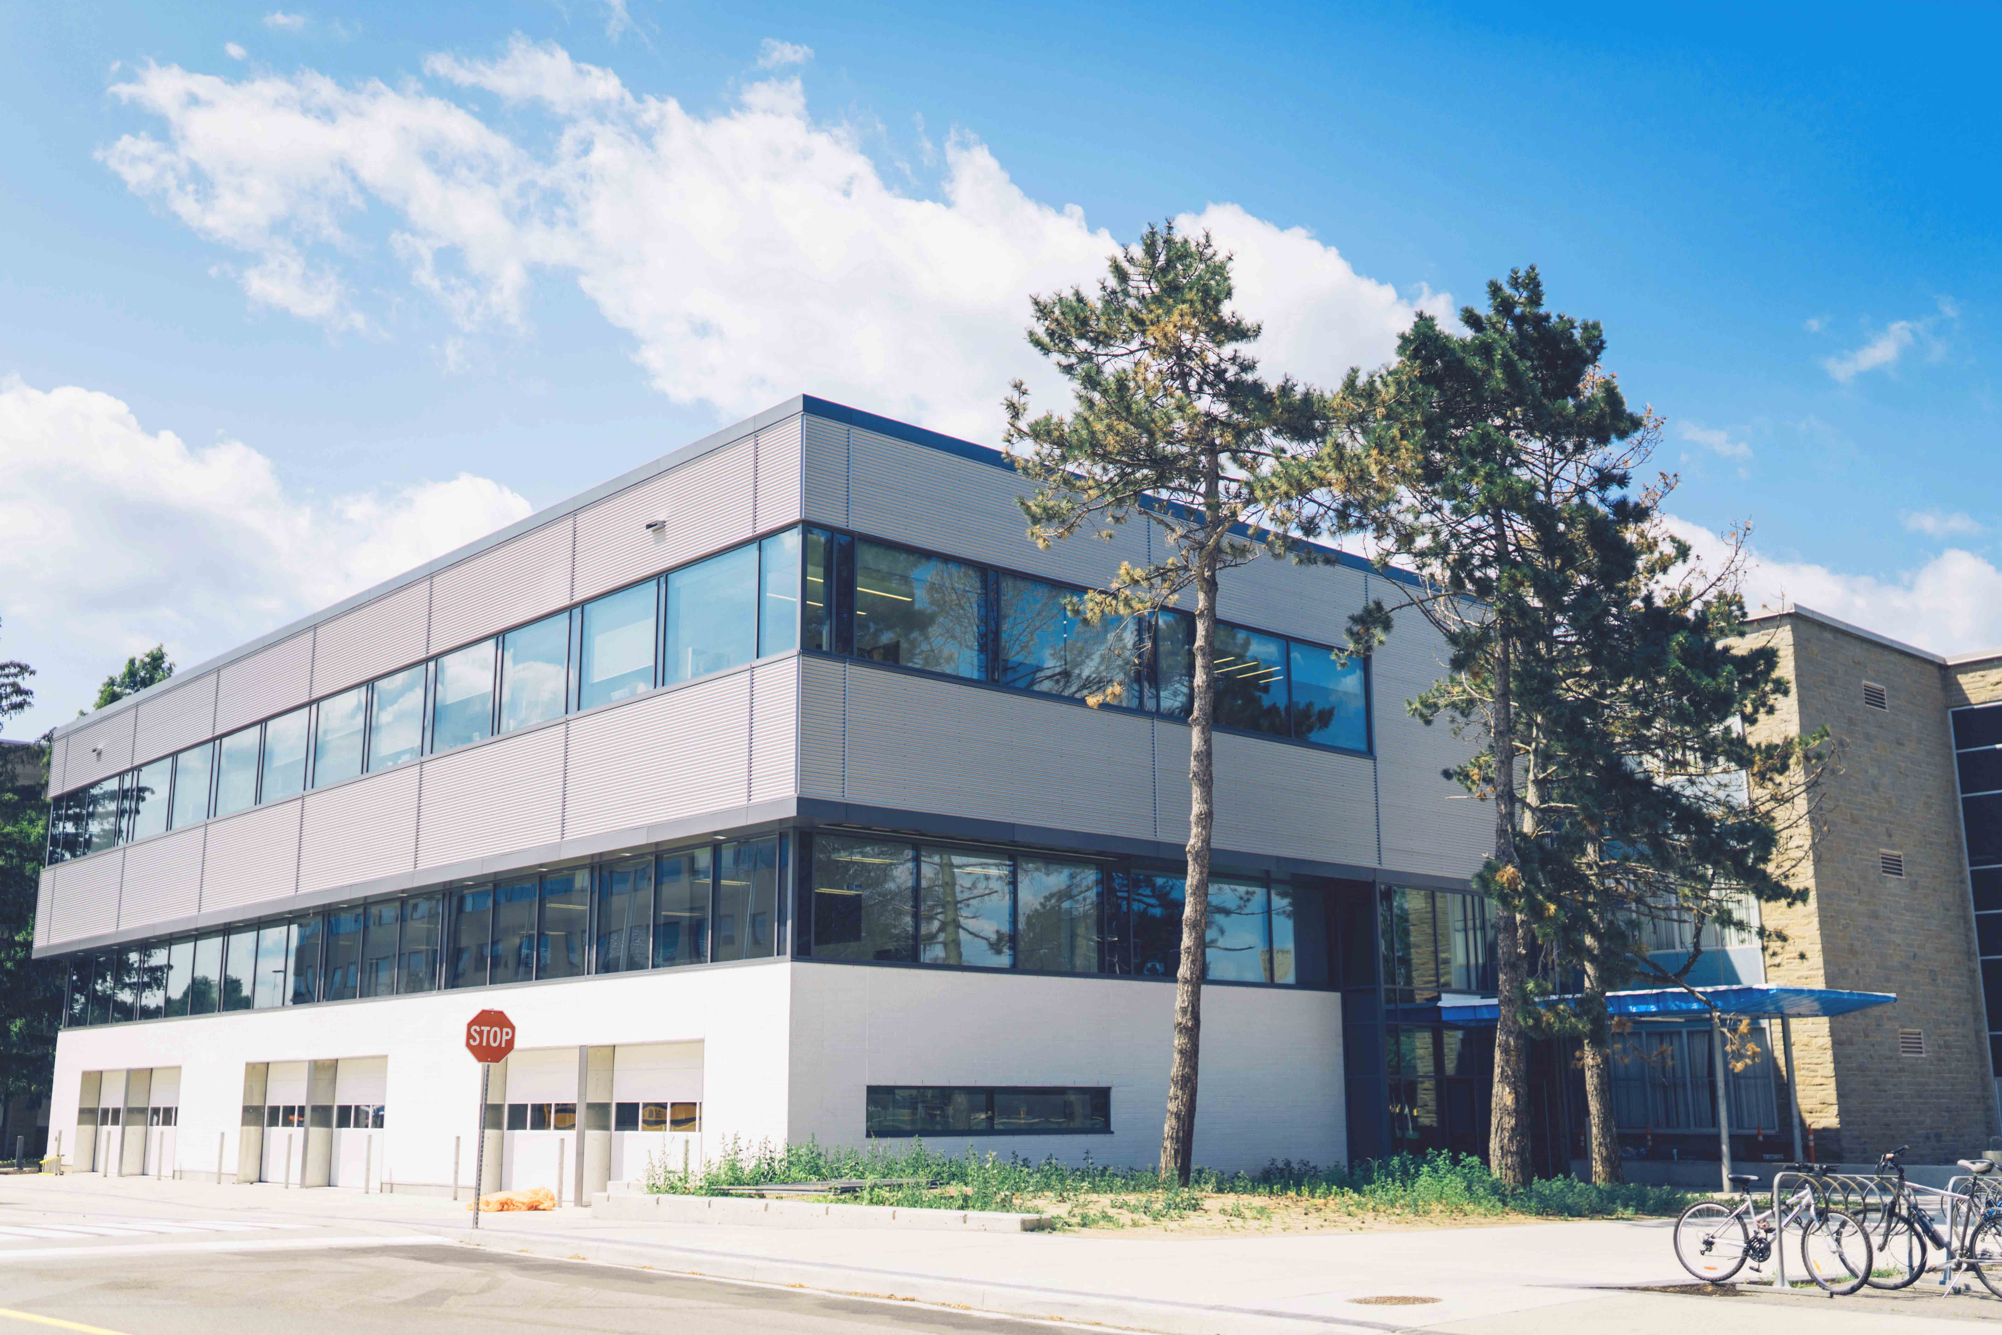
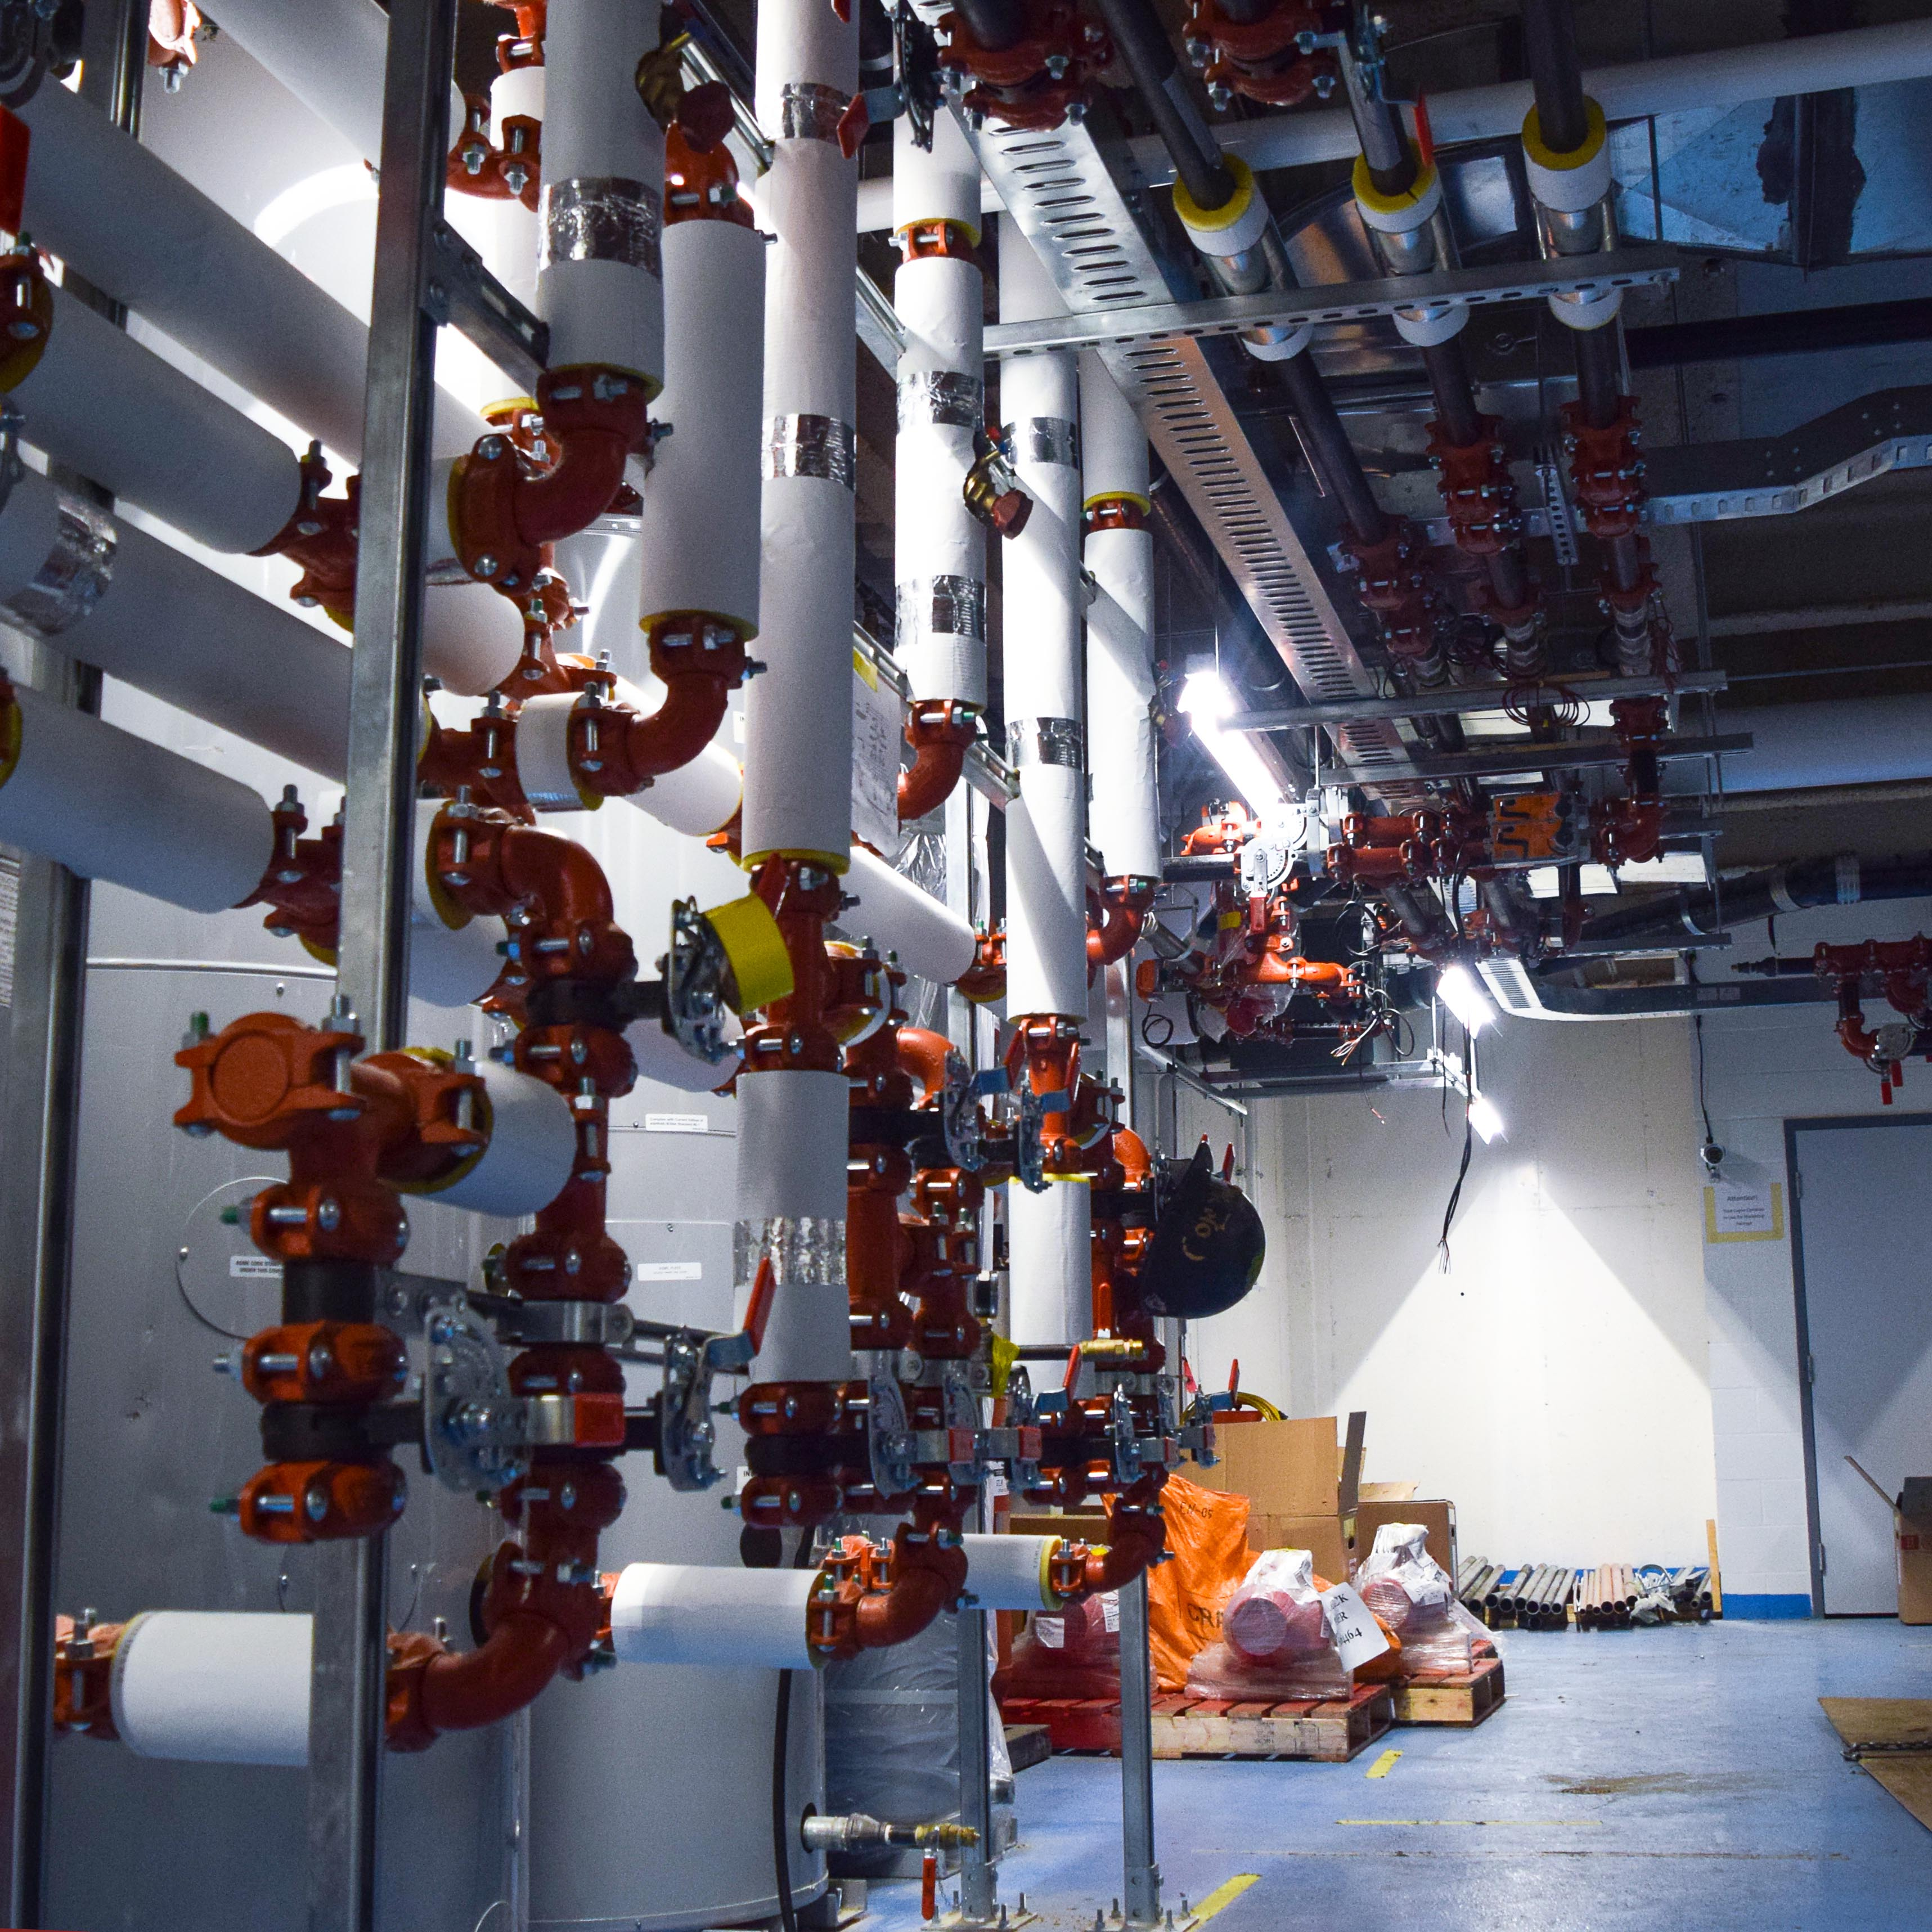
ICE Harvest Facility
21

Slide 6
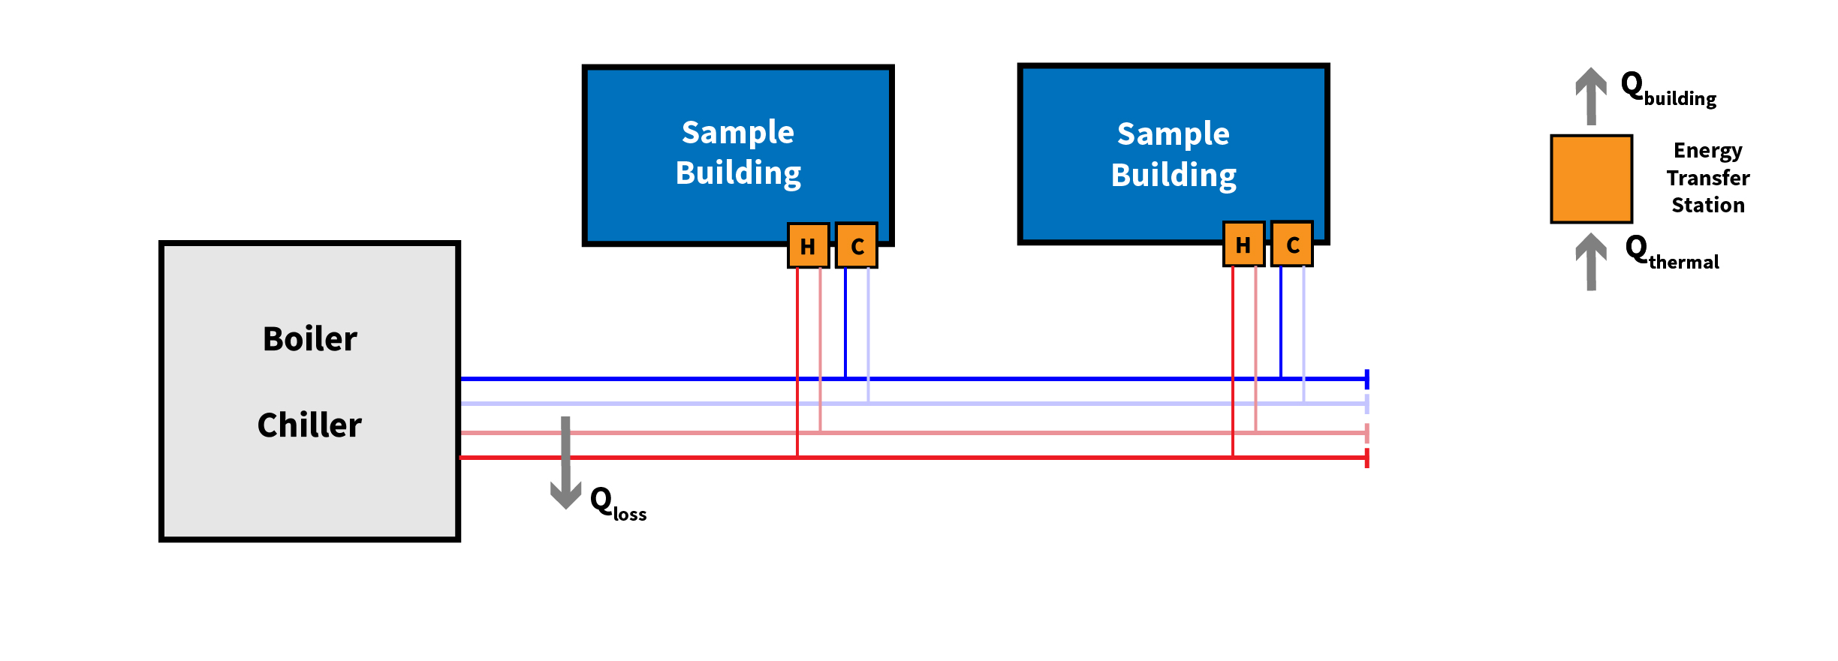
My Focus: Thermal Networks
Four Pipe Thermal Network
21

Slide 7
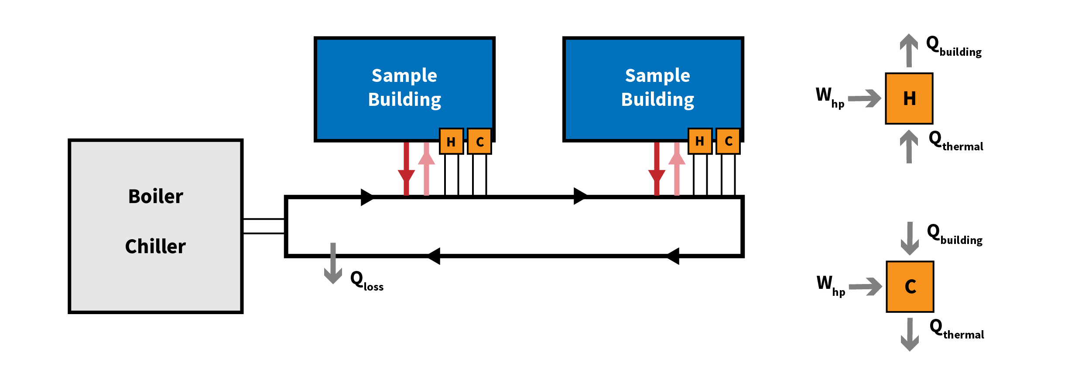
My Focus: Thermal Networks
One Pipe Thermal Network
21

Slide 8
Modelica Models
21

Slide 9
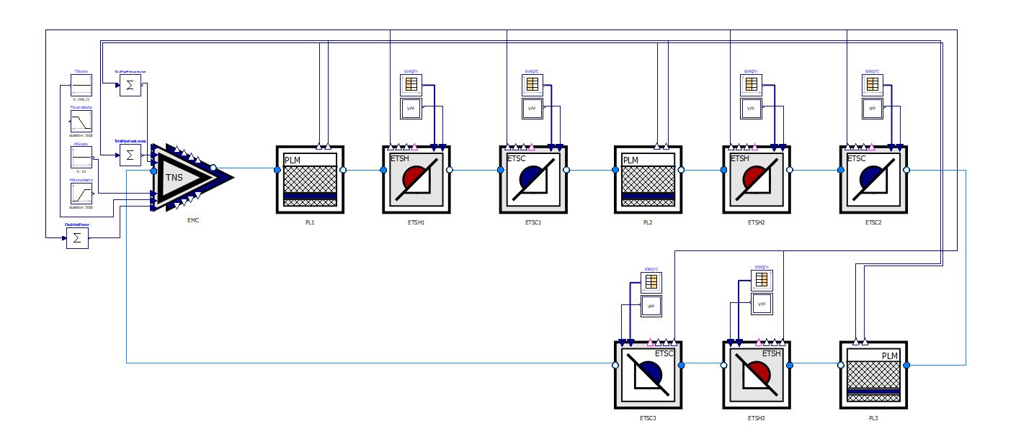
One Pipe Thermal Network
21
Notes:
Modules connected by fluid inlets. Loops back in a closed loop
Feedback, results and data transferred by real interfaces on the top
ETS hot and cold
PLM for losses in buried pipes
TNS that supply constant temperature water to the system.

Slide 10
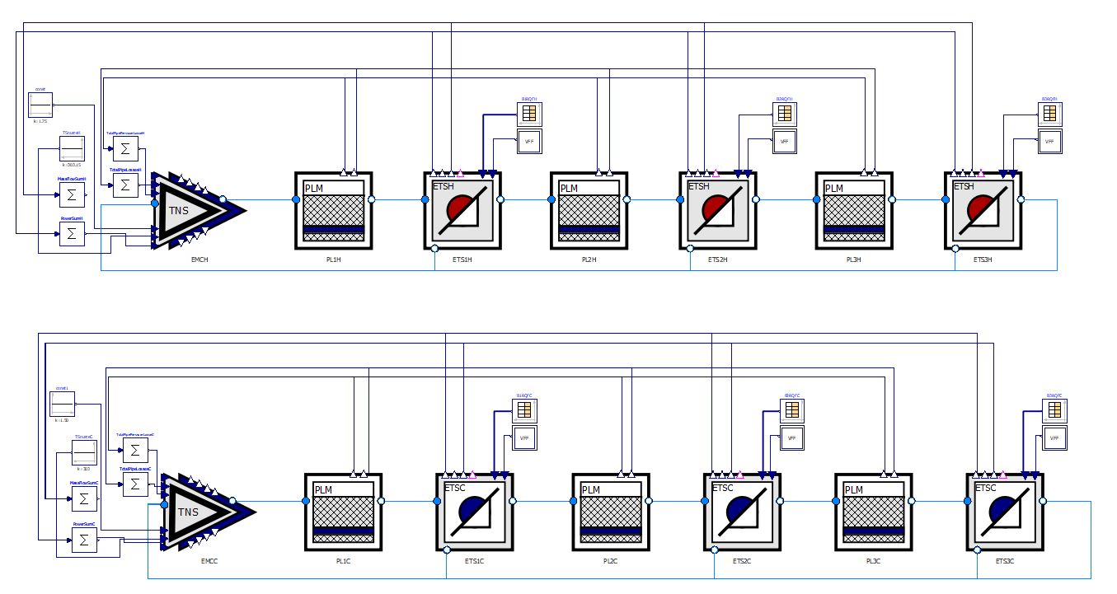
Four Pipe Thermal Network
21
Notes:
Two different pipe systems. Modules connected by fluid inlets. Although it loops back in a closed loop the last return is just a place holder to close off the system.
Feedback, results and data transferred by real interfaces on the top
ETS hot and cold
PLM for losses in buried pipes
TNS that supply constant temperature water to the system.

Slide 11
Case Study
21

Slide 12
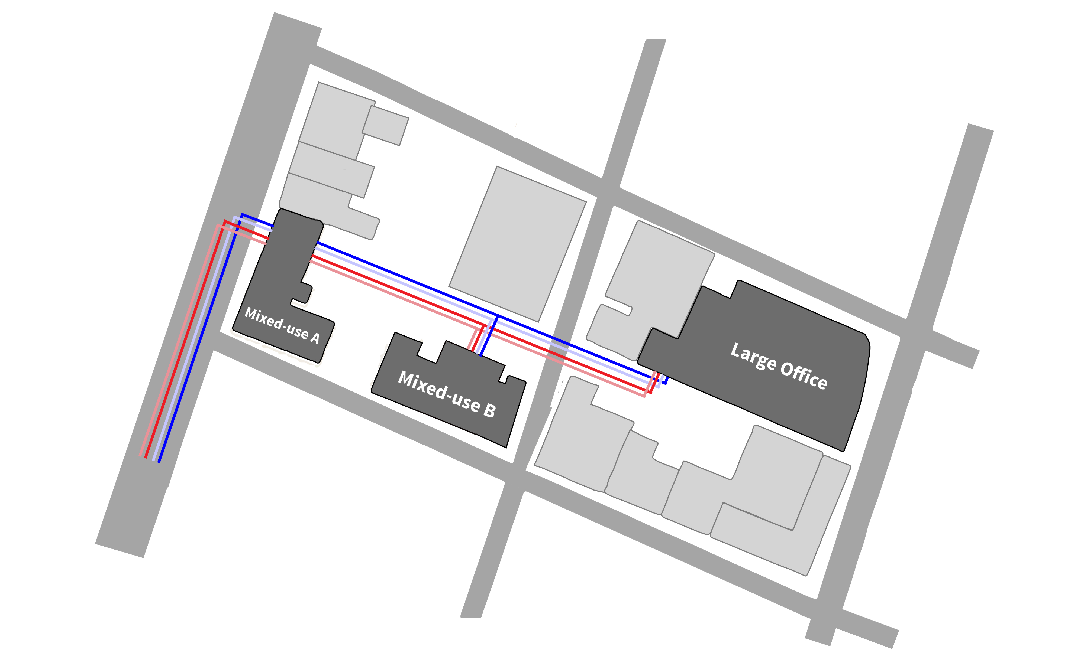
Case Study: 4PDH
21
Notes:
Mixed Use A : Herritage Building restored with resturants and offices
Mixed Use B : Herritage Building restored with resturants and apartments
Mixed Use A : General Office building restored with resturants and offices

Slide 13
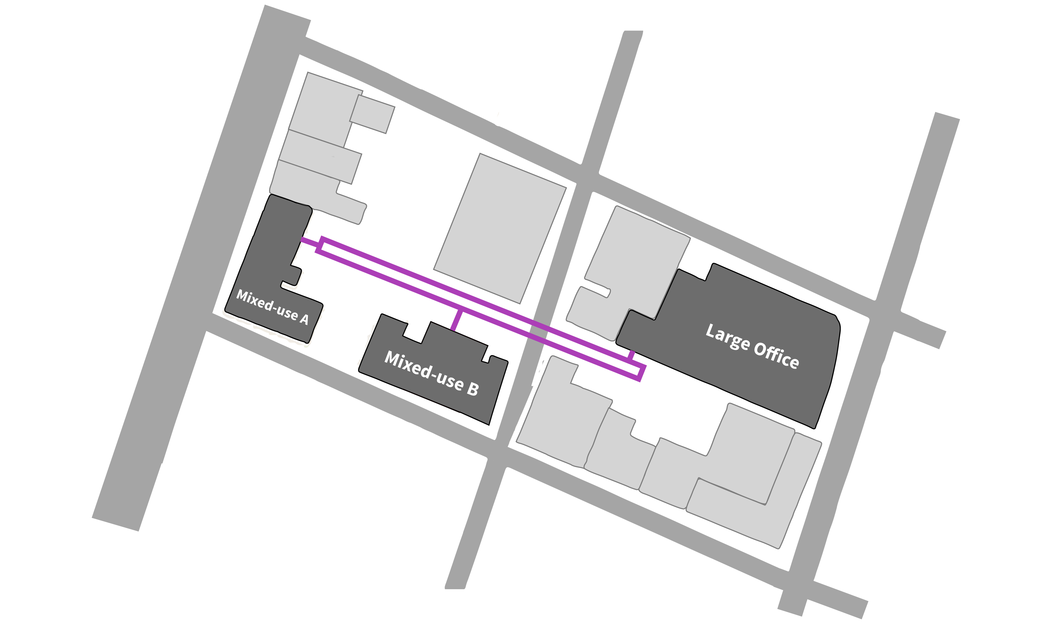
Case Study: 4PDH
21

Slide 14
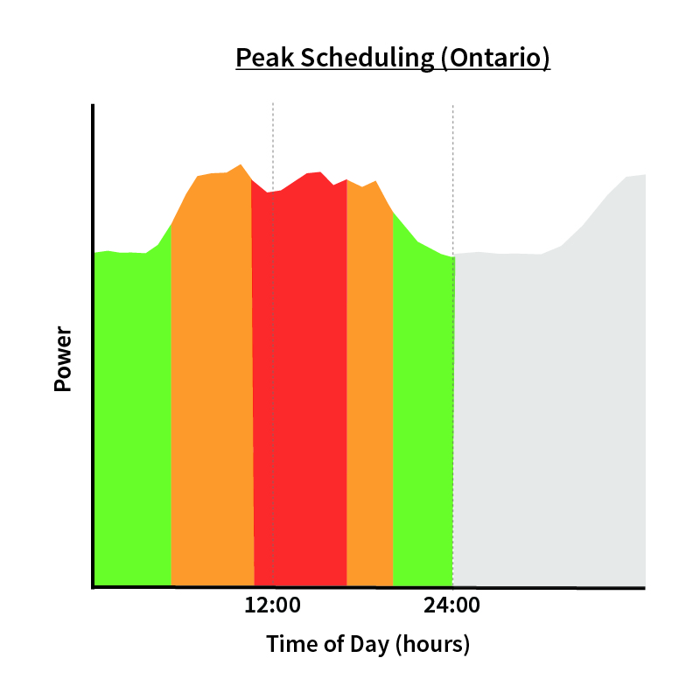
Energy Landscape
Time Of Use Pricing
Off Peak: 6.5¢ per kWh (0:00 – 7:00, 19:00 – 24:00)
Mid Peak: 9.4¢ per kWh (7:00 – 11:00, 17:00 – 19:00)
On Peak: 13.2¢ per kWh (11:00 – 17:00)
Gas Pricing
13.18¢ per m³
21
Notes:
Show the PPT demand schedule, broken down by type
Explain the agility of different energy sources
Explain the reliability of renewables
This is peak dependence on non renewables is an issue because of the current structure of the grid and the inherent inefficiencies with fossil fuel generation.
Show the excess heat generation that is wasted to the environment

Slide 15
Potential Problem
One Pipe Thermal Network
21

Slide 16
Solution 1:
CHP and Back Up Boiler
Heating Supply:
On Peak: CHP used to provide heat for thermal network and electricity for heat pumps
Off Peak: Boiler used to provide heat and grid used to provide electricity for heat pumps (grid pricing)
Cooling Supply: Electric Chiller
Solution 2:
CHP and Ground Source Heat Pump
Heating Supply:
On Peak: CHP used to provide heat for thermal network and electricity for heat pumps
Off Peak: Ground Source Heat Pump used to provide heat and grid used to provide electricity for heat pumps
Cooling Supply: Electric Chiller
21

Slide 17
Results Heating and Cooling
21

Slide 18
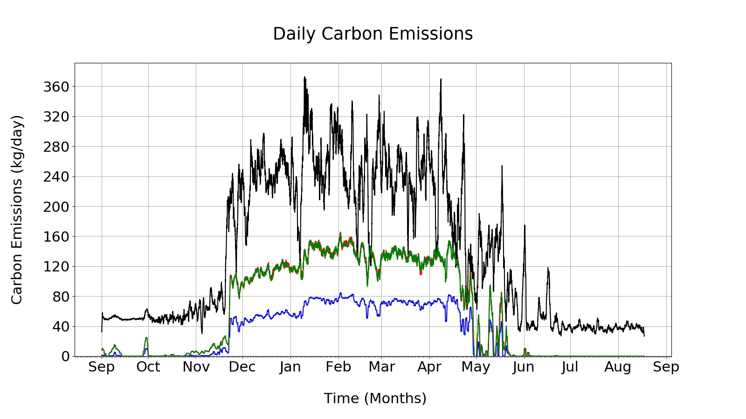
Black: Four Pipe Thermal Network
Green: One Pipe Thermal Network
Red: Solution 1: One Pipe Thermal Network (CHP and Boiler)
Blue: Solution 2: One Pipe Thermal Network (CHP and Heat Pump)
21

Slide 19
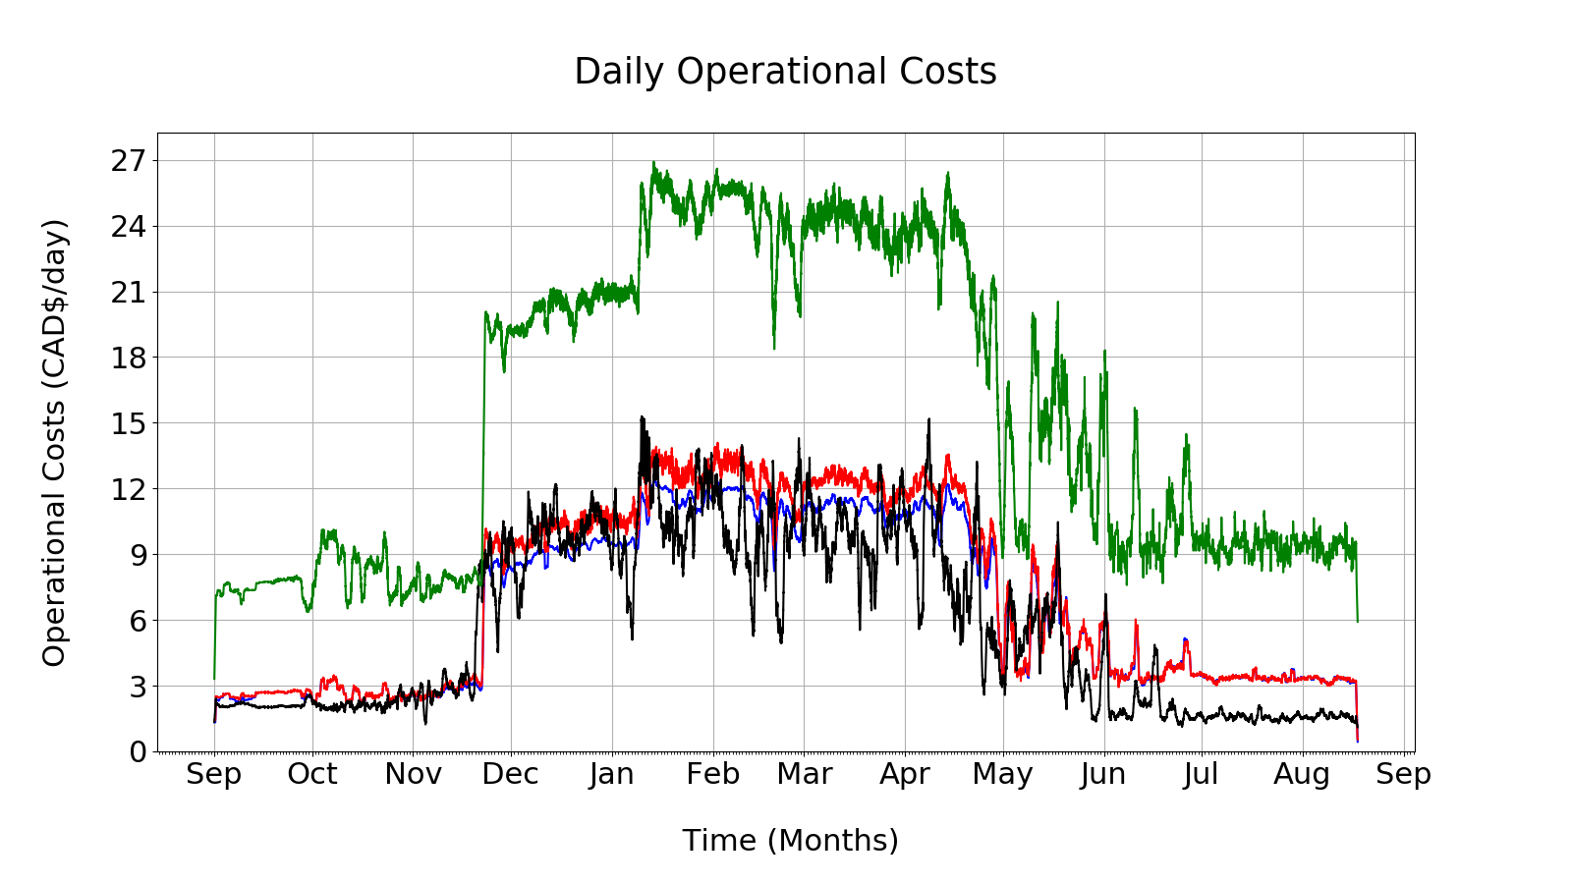
Black: Four Pipe Thermal Network
Green: One Pipe Thermal Network
Red: Solution 1: One Pipe Thermal Network (CHP and Boiler)
Blue: Solution 2: One Pipe Thermal Network (CHP and Heat Pump)
21

Slide 20
Summary
One Pipe Thermal Networks
Reduce carbon emissions by shifting heating load from boilers to heat pumps
Cost more operationally, but can be made cost competitive by
changing the energy mix (local peaking power plant integration)
capturing waste energy (future area of research)
Reduce the total energy demand by creating a shared energy loop that allows the cooling and heating demands to counteract each other.
21

Slide 21


Thank You For Listening
energy.mcmaster.ca
rogersrb@mcmaster.ca

